Slide 1

a report to our
investors

Slide 2
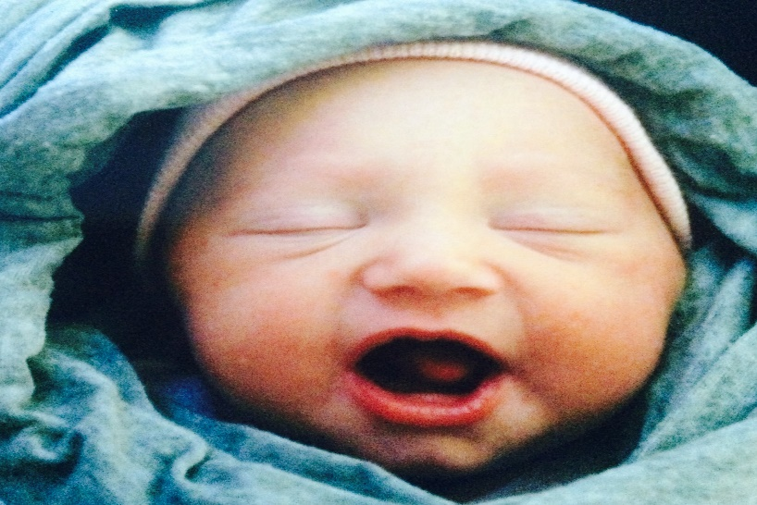
MINISTRY RESULTS from 2016
Residents at Hannah House 13
Residents facing addiction 6
Residents in mental health treatment 12
Babies born to HH residents 13
New client intakes 365
Parenting Groups attendance 583
Material Support visits 2,296
Total instances of service 4240

Slide 3

MINISTRY RESULTS as of June 30, 2017
Residents at Hannah House 10
Residents in mental health treatment 9
Residents facing addiction 7
Babies born to HH residents 4
New client intakes 139
Material Support visits 946
Parenting Groups attendance 240

Slide 4
2016 BUDGET
Income
Churches
Monthly Donors
Hannah-Thon
Walk 4 Life
Gala
Misc Fundraisers
Large Donations
Sporadic
Total
Expenses
Payroll
Utilities & Maint.
Office & IT
Insurance
Advertising
Training & Travel
Misc: Dues/Events/Food
$56,000
$50,000
$34,000
$38,000
$47,000
$6,000
$66,000
$145,400
$442,400
$348,000
$32,000
$25,300
$16,000
$5,600
$3,650
$11,400
$441,950
Total

Slide 5
INCOME & EXPENSES
2016 2017

Slide 6
OUR CHALLENGES
Currently
Complications
    Rising expenses: capital repairs & more serious client needs
    Aging donor base, number of churches decreasing, & lower giving amounts, despite increase in number of donors
    Staff retention: Delayed staff raises & lack of health insurance
    Escalating HH repairs
    Replacement of 2 vehicles in 2018
Tina was on medical leave for almost three months
Currently, no development staff
Resolutions
Increase donor base to increase budget in needed areas
Find a group of core donors to make a 2-year commitment totaling $150k/yr
Consider selling & moving

Slide 7
DONOR PYRAMID
2017 (YTD)
2016
2015
10k+
5k-9,999
2k-4,999
1k-1,999
100-999
<100
Total
2
4
7
15
164
118
310
10k+
5k-9,999
2k-4,999
1k-1,999
100-999
<100
Total
7
6
19
47
259
320
658
10k+
5k-9,999
2k-4,999
1k-1,999
100-999
<100
Total
4
14
20
43
279
273
633

Slide 8
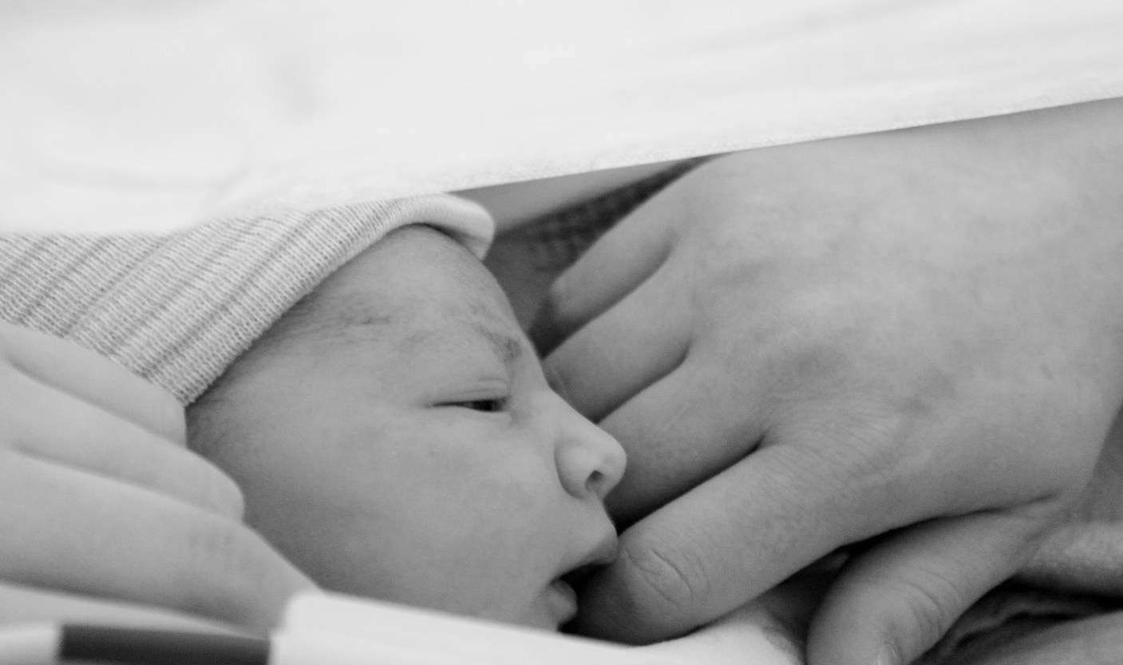
RECAP
&
discussion

Slide 9
a report to our
investors

