Slide 1

annual
report

Slide 2
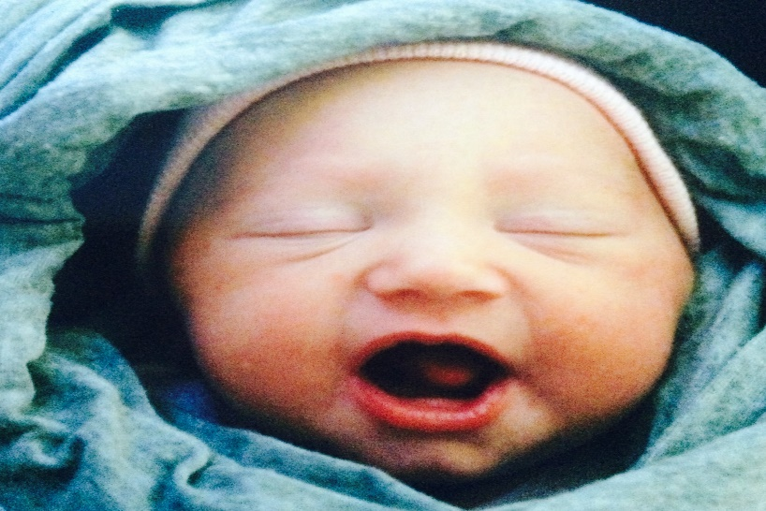
MINISTRY RESULTS from 2018
New Client Intakes 362
Children’s Place Visits 1344
Parenting Classes 85
Clients in Parenting Class 103
Material Support Visits 2011
__________________________________
100% of Abortion Minded and
Abortion Vulnerable Clients Chose Life!

Slide 3
2018 Finances
$2,116
$427
$1,000
$10,080
$28,296
$163,538
$42,724
$591
$251,086
Income
Baby Bottles
Churches
Gala
Hannah-Thon
Individual Gifts
Monthly Donors
Walk for Life
Individual Gifts
Totals
Expenses
Advertising
Donation Processing Fees
Employee Benefits
Insurance
Occupancy
Payroll Expenses
Program & Admin Expenses
Staff Training
Totals
$4,689
$59,297
$77,321
$36,125
$20,824
$88,608
$33,434
$20,824
$320,298

Slide 4

Praising God for Answered Prayers
Hannah House has received a much needed refurbishing including:
Water damage repair of dining room wall
A new roof (to prevent future damage)
Repainting of the home’s interior
New HVAC unit installed
More functional dressers and nightstands in the bedrooms

Slide 5
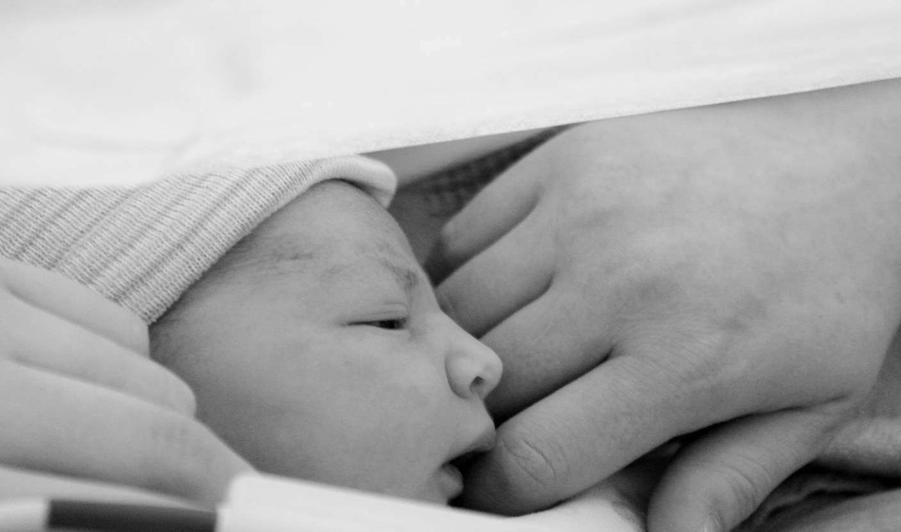
OUR CURRENT CHALLENGES AND MORE URGENT NEEDS
    We are ready to reopen Hannah House, as soon as we can hire an overnight/live-in residential assistant and evening/weekend residential assistants. Leadership staff have been hired.
    In the Summer, we have fewer volunteers and interns. Client Care, Hannah House, Fundraising, and Administrative help is needed.
    We continue to need more larger-sized diapers, Pull-Ups, and unscented wipes.

Slide 6
For more information on our programs or to volunteer, please visit hannahcenter.org, call 812-334-0104, or email info@hannahcenter.org to schedule a tour of the ministry.

