Slide 1

2019
Annual report
Hannah Center and
Hannah House Maternity Home

Slide 2
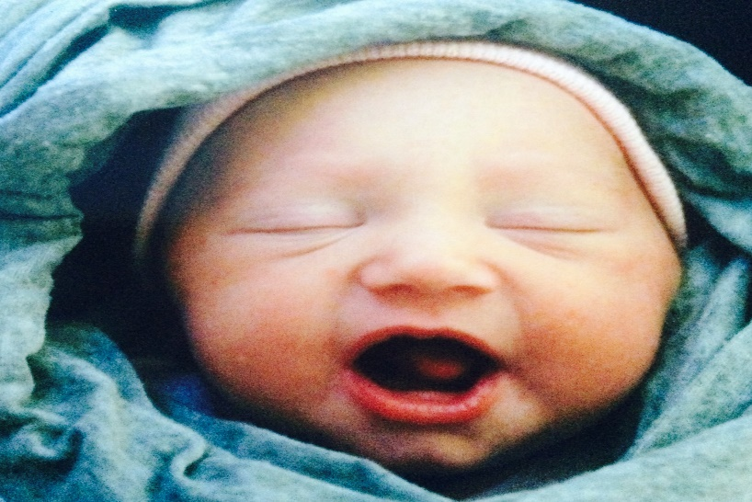
MINISTRY RESULTS from 2019
New Client Intakes 187
Children’s Place Visits 989
Parenting Classes 84
Material Support Visits 3082
__________________________________
100% of Abortion Minded and
Abortion Vulnerable Clients Chose Life!

Slide 3
2019 Finances
$1,998
$2,306
$899
$12,086
$43,321
$228,013
$47,512
$2,063
$1,276
$339,474
Income
Baby Bottles
Businesses
Churches
Gala
Hannah-Thon
Walk for Life
Individual Gifts
Totals
Expenses
Advertising
Designated Client Need
Donation Processing Fees
Insurance
Occupancy
Payroll
Program & Admin Expenses
Technology
Travel & Mileage
Totals
$9,494
$57,046
$40,347
$59,423
$44,936
$32,211
$68,754
$312,211
Note: Our 2019 Expenses are higher than our income because we did a large number of capital improvements to Hannah House. We hired staff to specifically focus on the repairs and remodeling. Most of the funds for the project were raised in 2018, so they are not reflected on this report. All repairs were completed without borrowing money. God has blessed us to remain debt-free.

Slide 4
Please keep our staff in your prayers
Tina Lampke, Executive Director - 24 years of service
Angie Grooms, Director – 15 years of service
Kristi Pietz, Client Services Director – 3 years of service
Shelonda Bledsoe, Residential Care Director & Certified Doula – 5 years of service
Liz Franklin, Hannah House Director – First year of service
Ashley Barnhill, Children’s Place Assistant - 2 years of service
Katherine Lampke, Marketing Assistant & Social Media Manager, 2 years of service

Slide 5
CURRENT CHALLENGES AND MORE URGENT NEEDS
    The COVID-19 crisis increased our number of clients served by 32 percent within a two-week period. Many people who have never needed help are asking for the first time.
    We need larger-sized diapers, Pull-Ups, and unscented wipes to meet the increased needs.
    More masks, hand sanitizer, Lysol spray, and bleach wipes are needed.
    In addition to serving more clients, our donations, especially from local businesses, has significantly decreased due to the financial challenges that have accompanied COVID-19.

Slide 6

For more information on our programs or to volunteer, please visit hannahcenter.org, call 812-334-0104, or email info@hannahcenter.org to schedule a tour of the ministry.

Slide 7
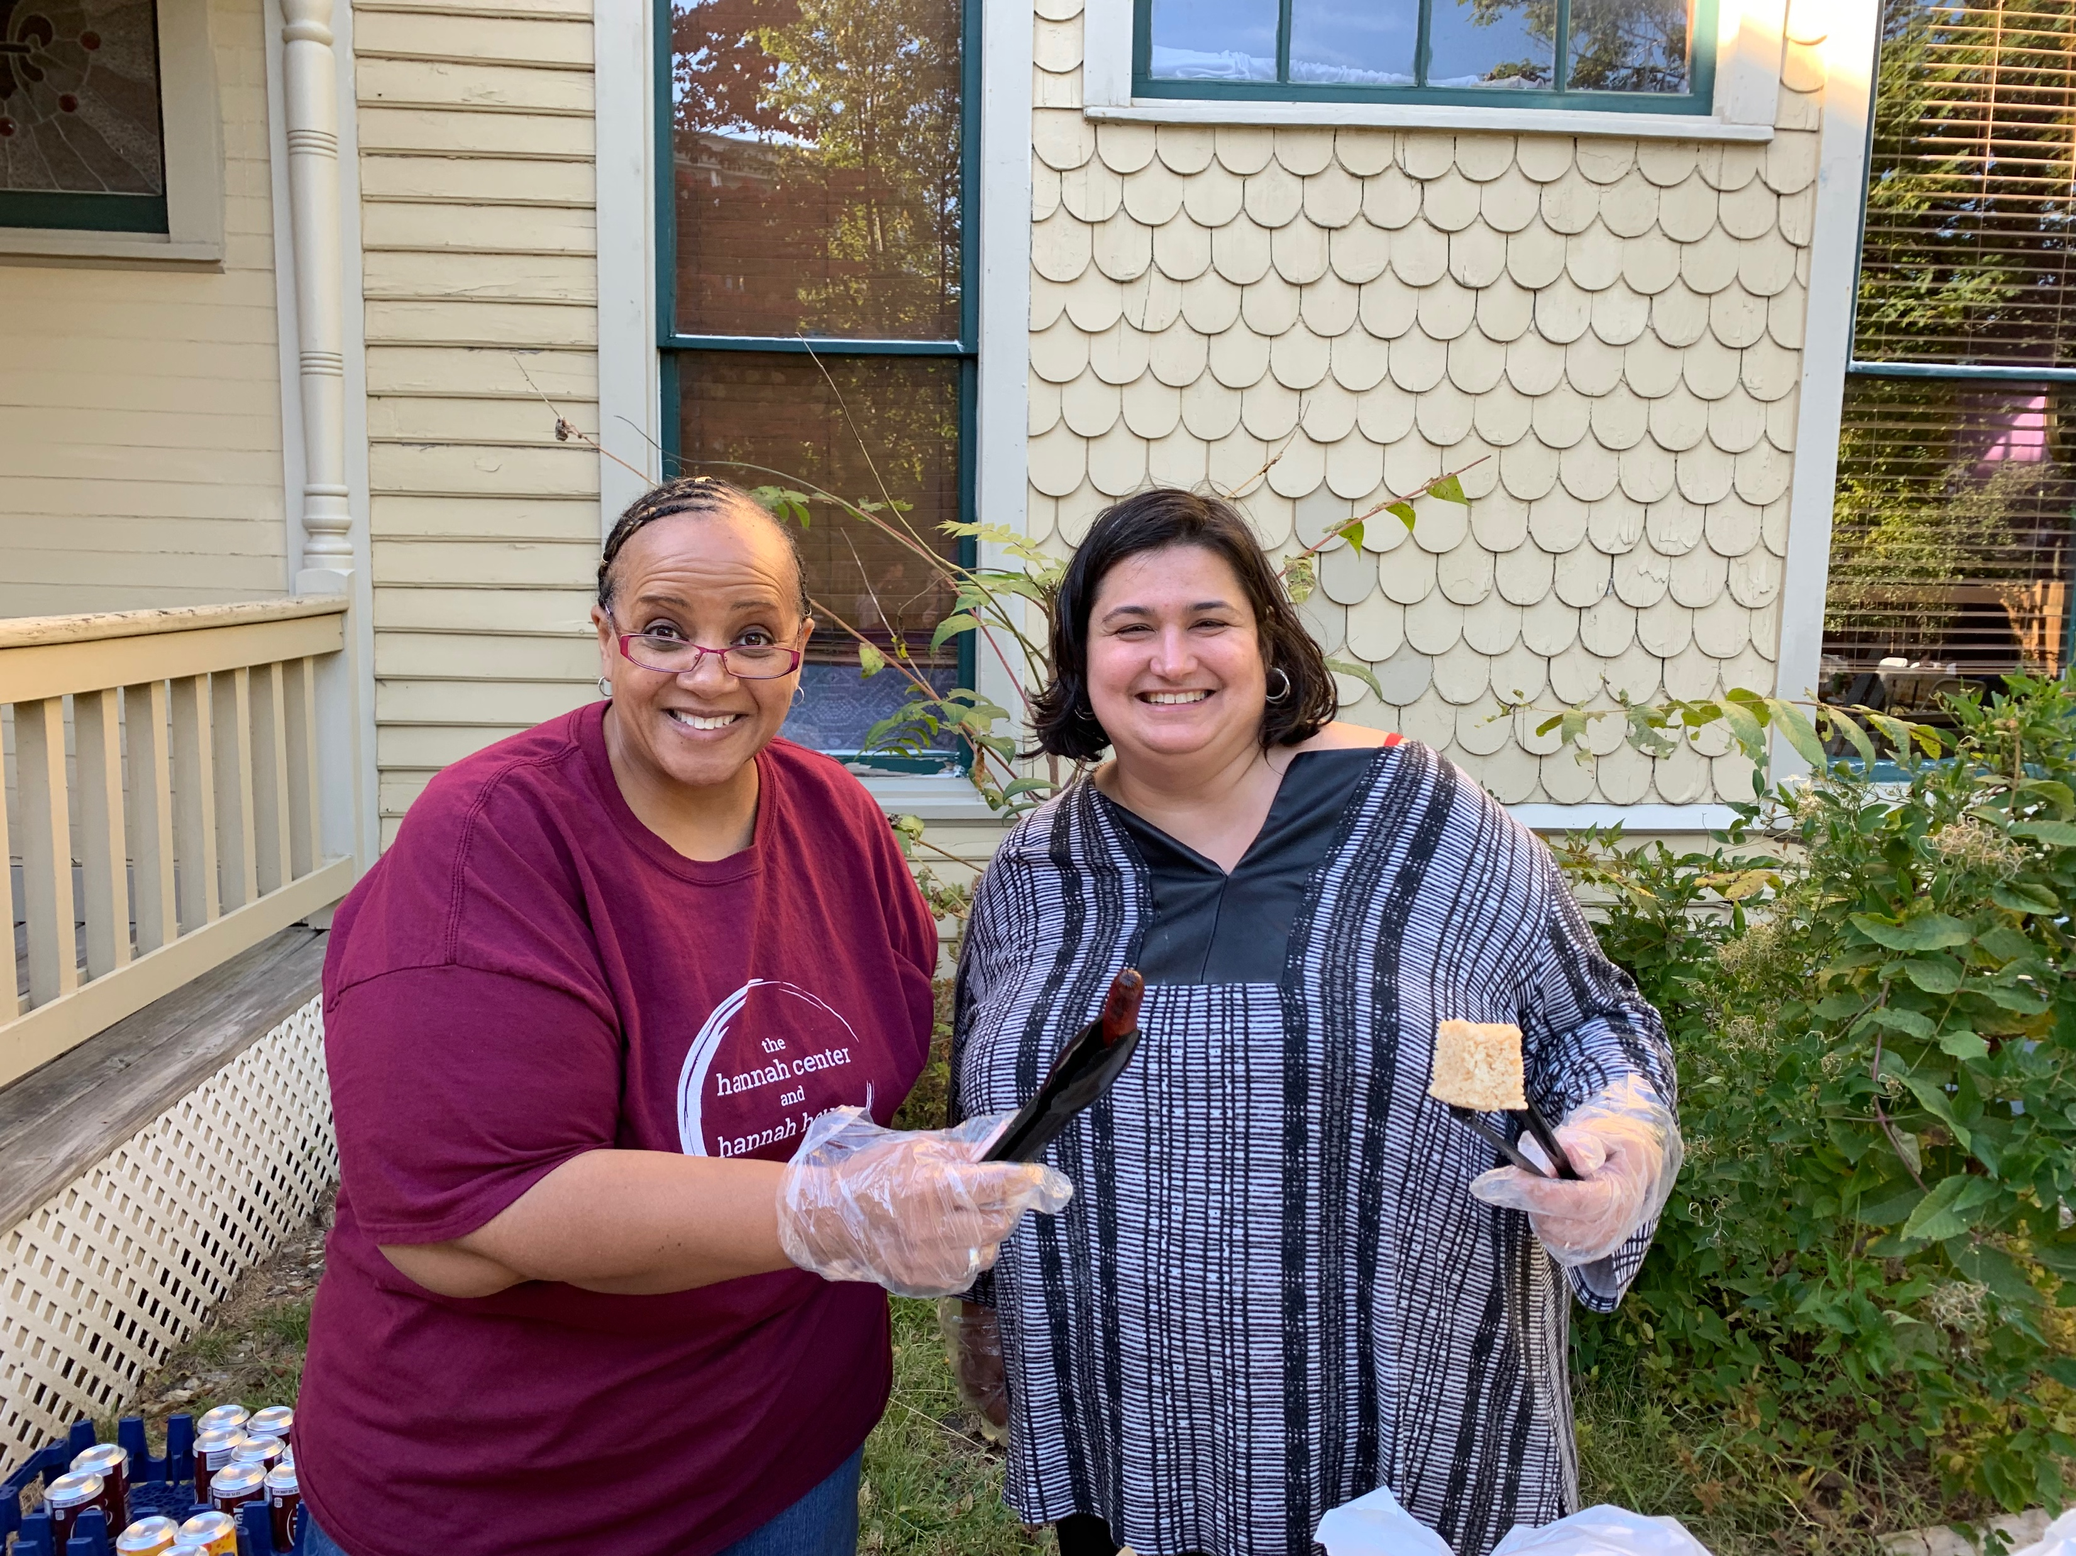
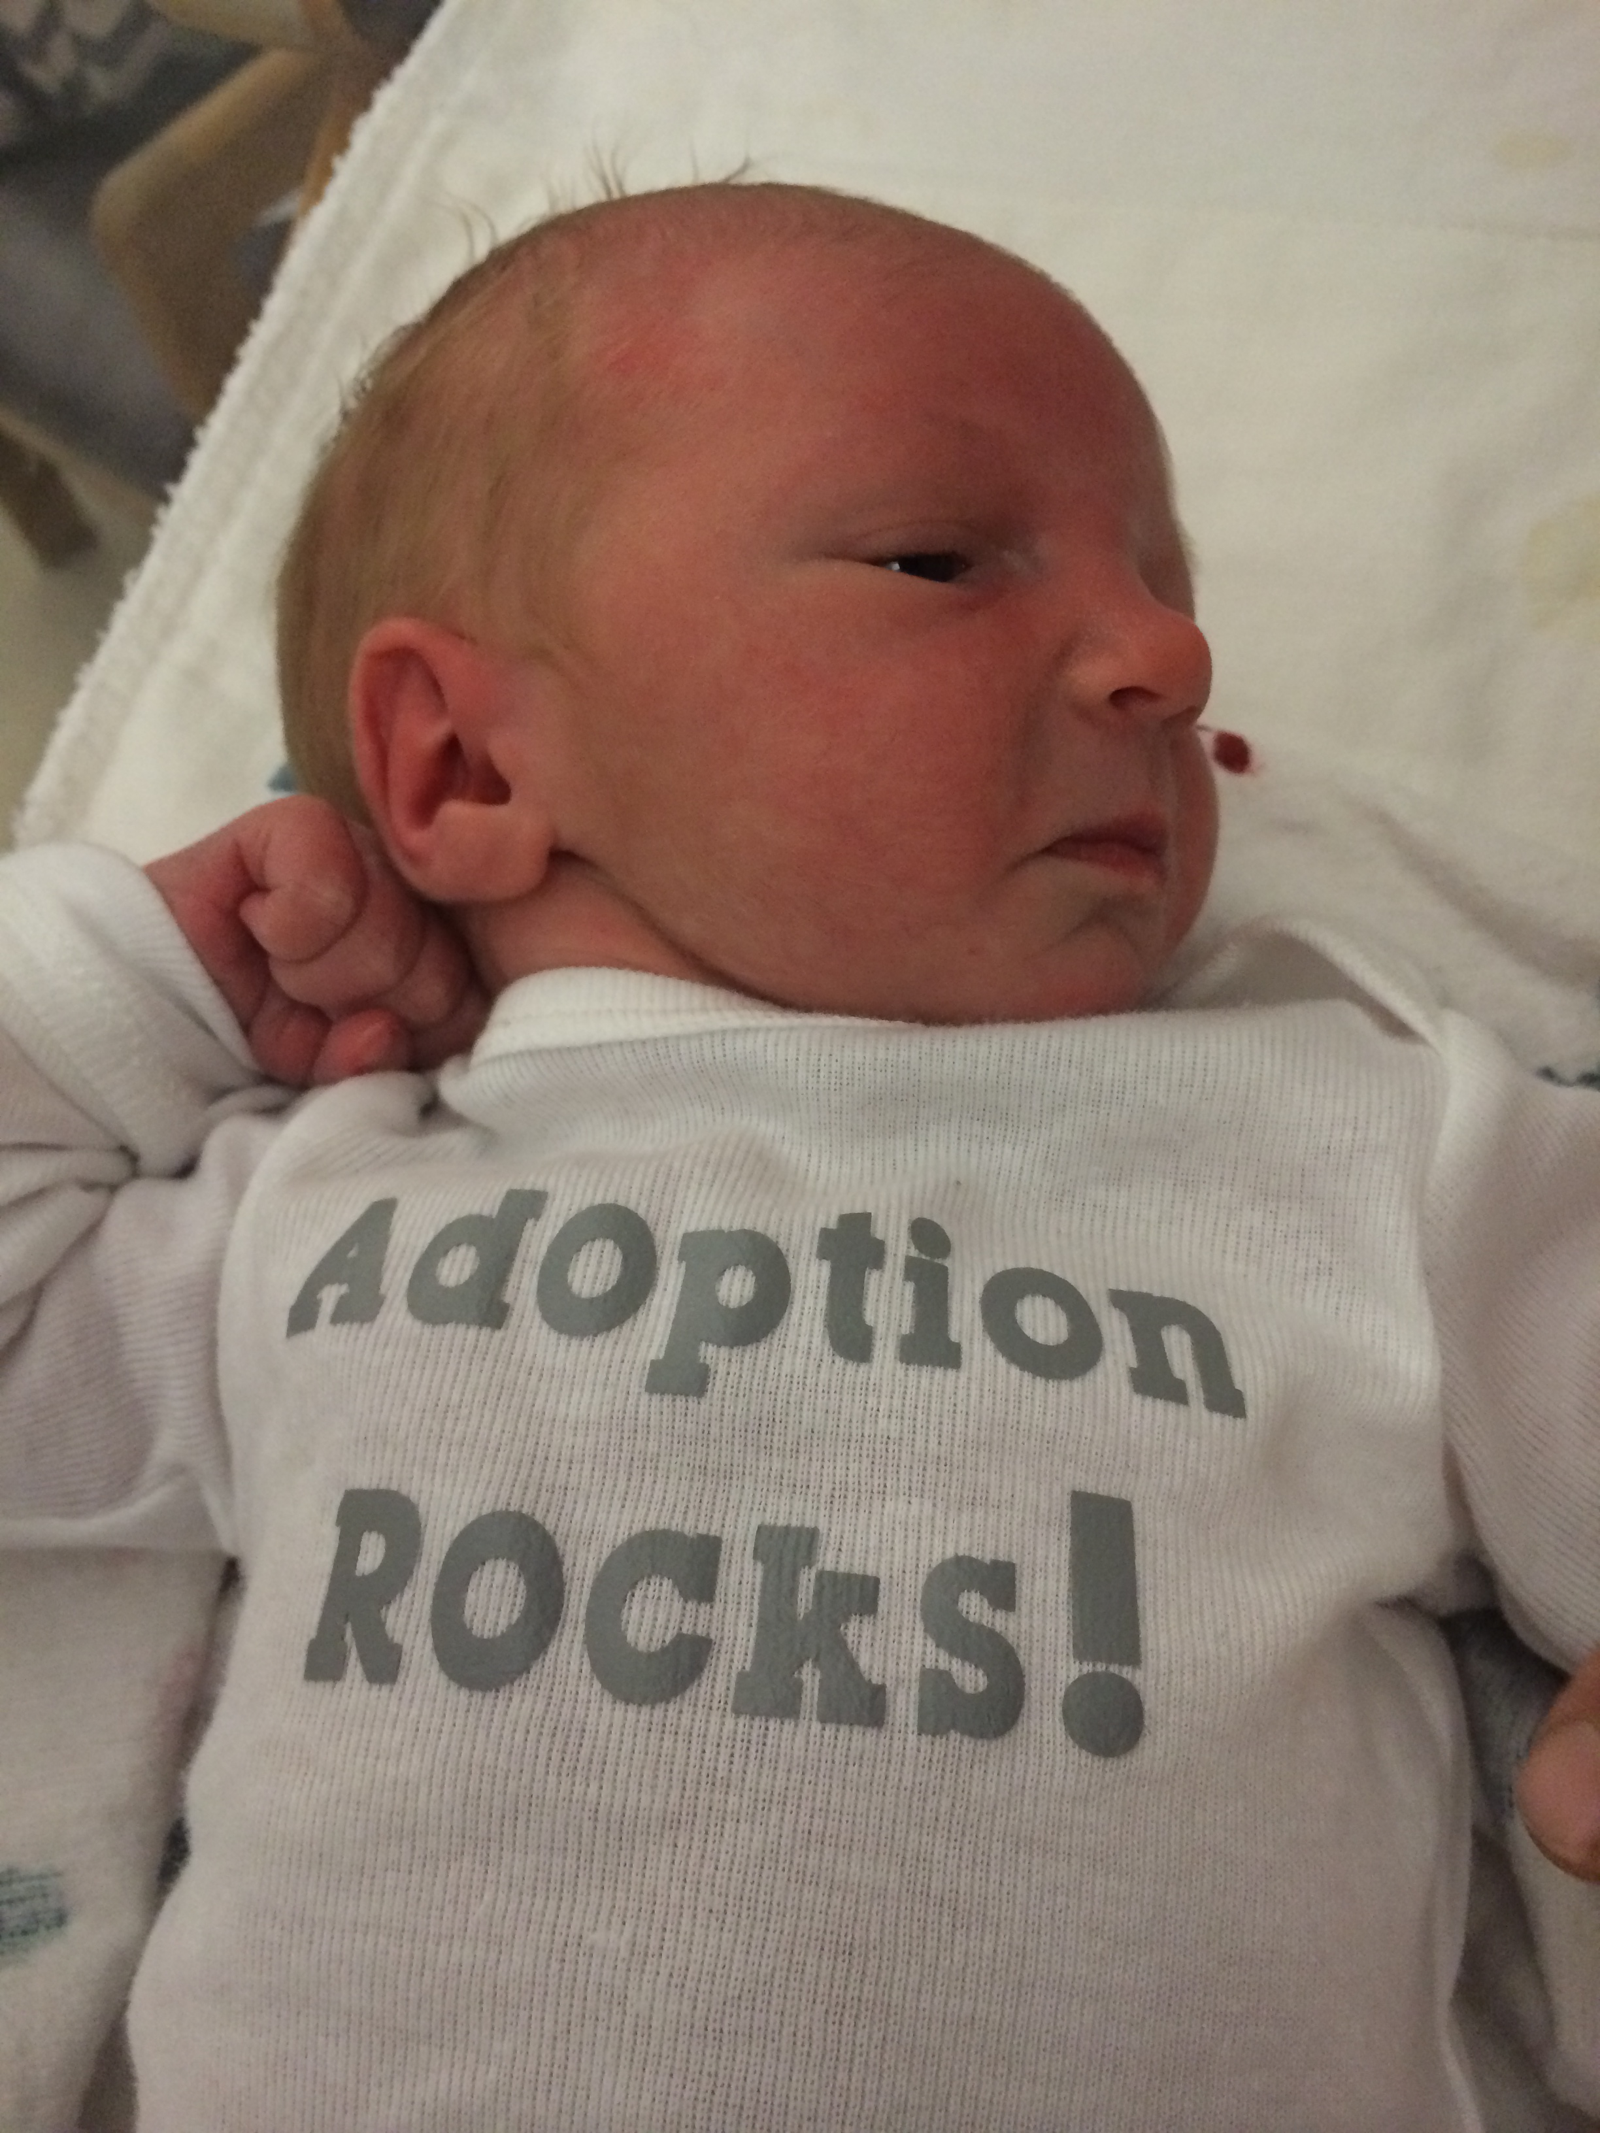
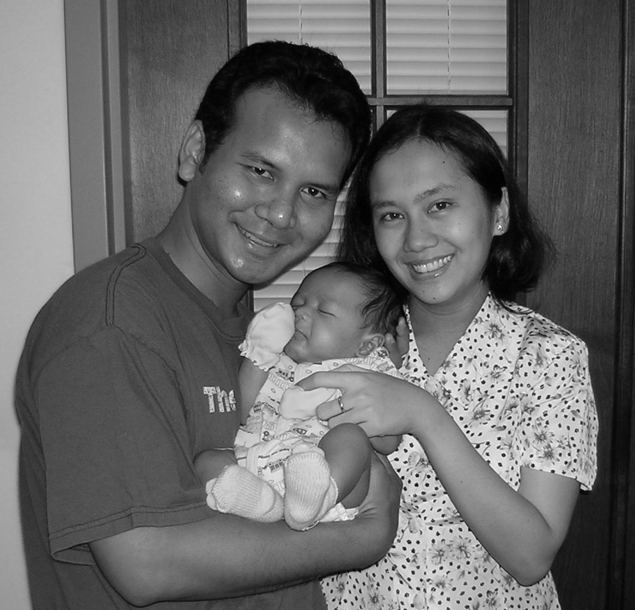
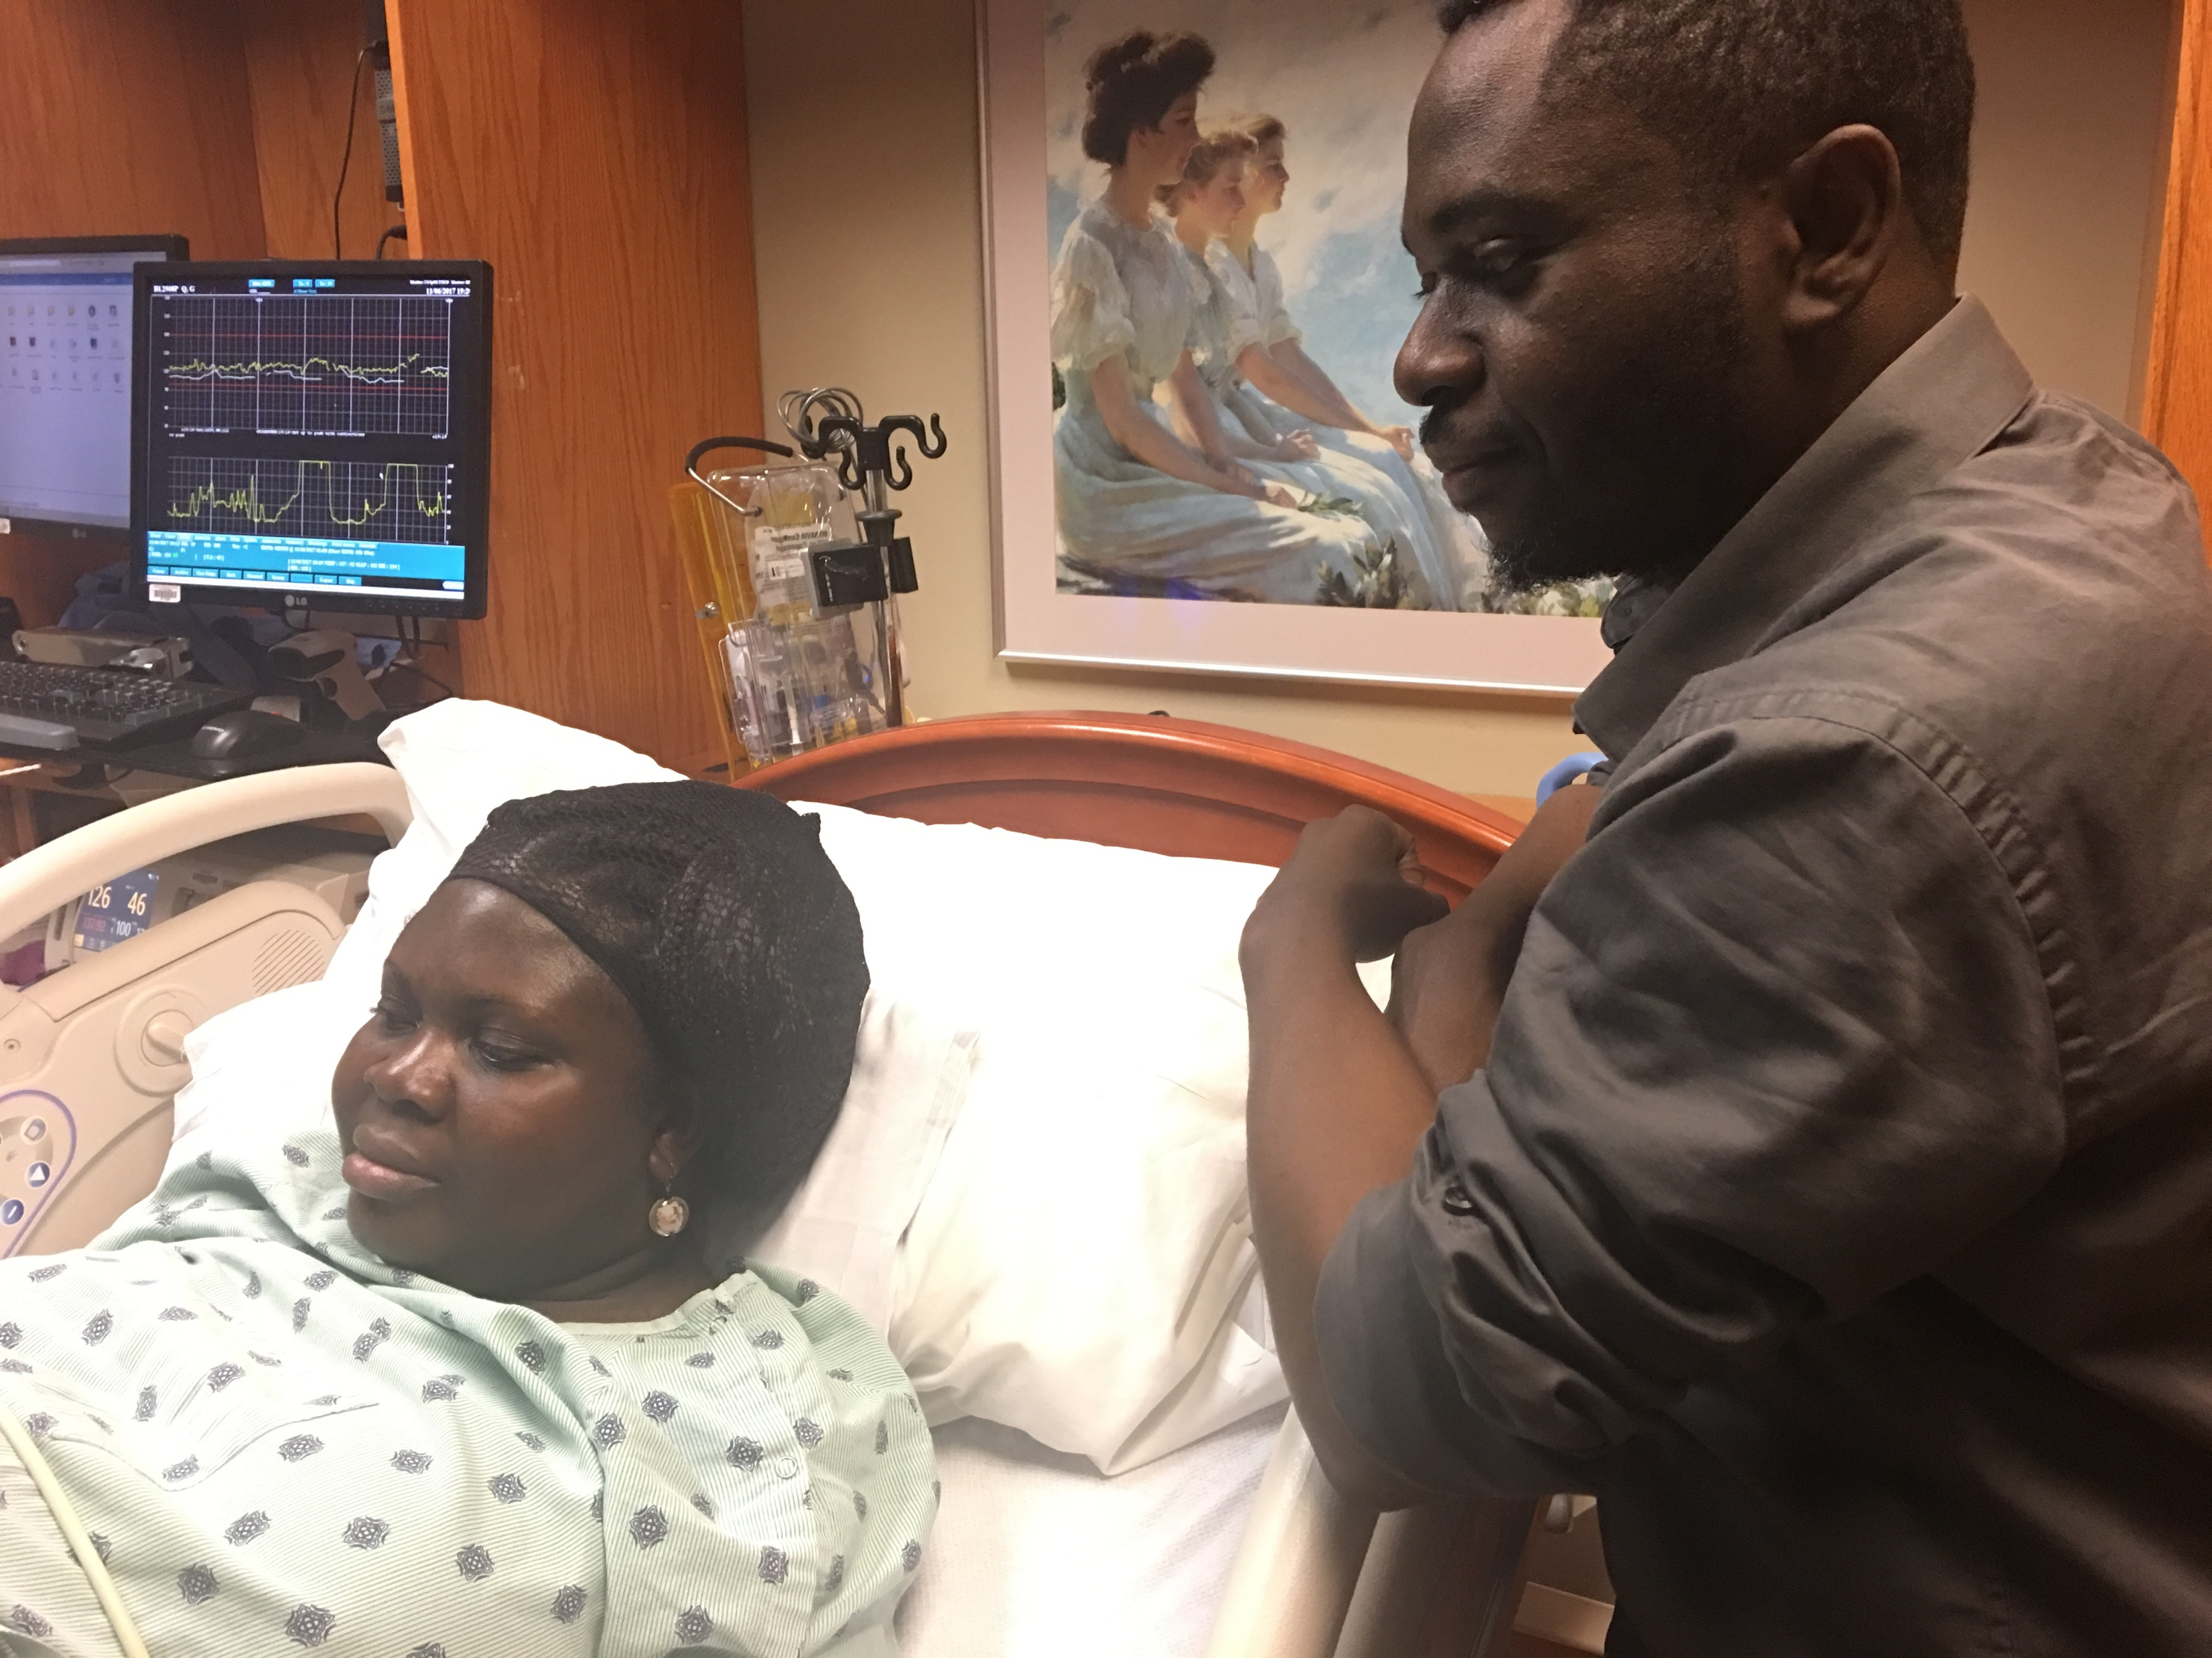
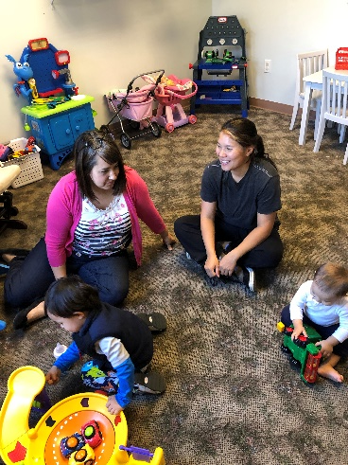
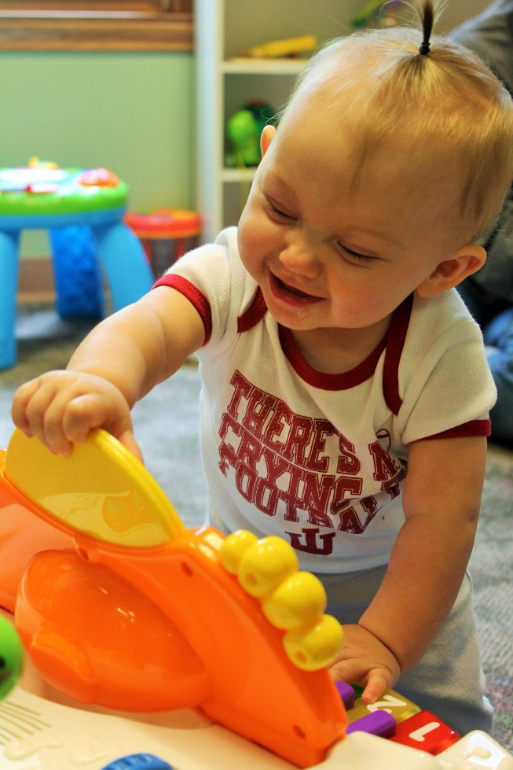
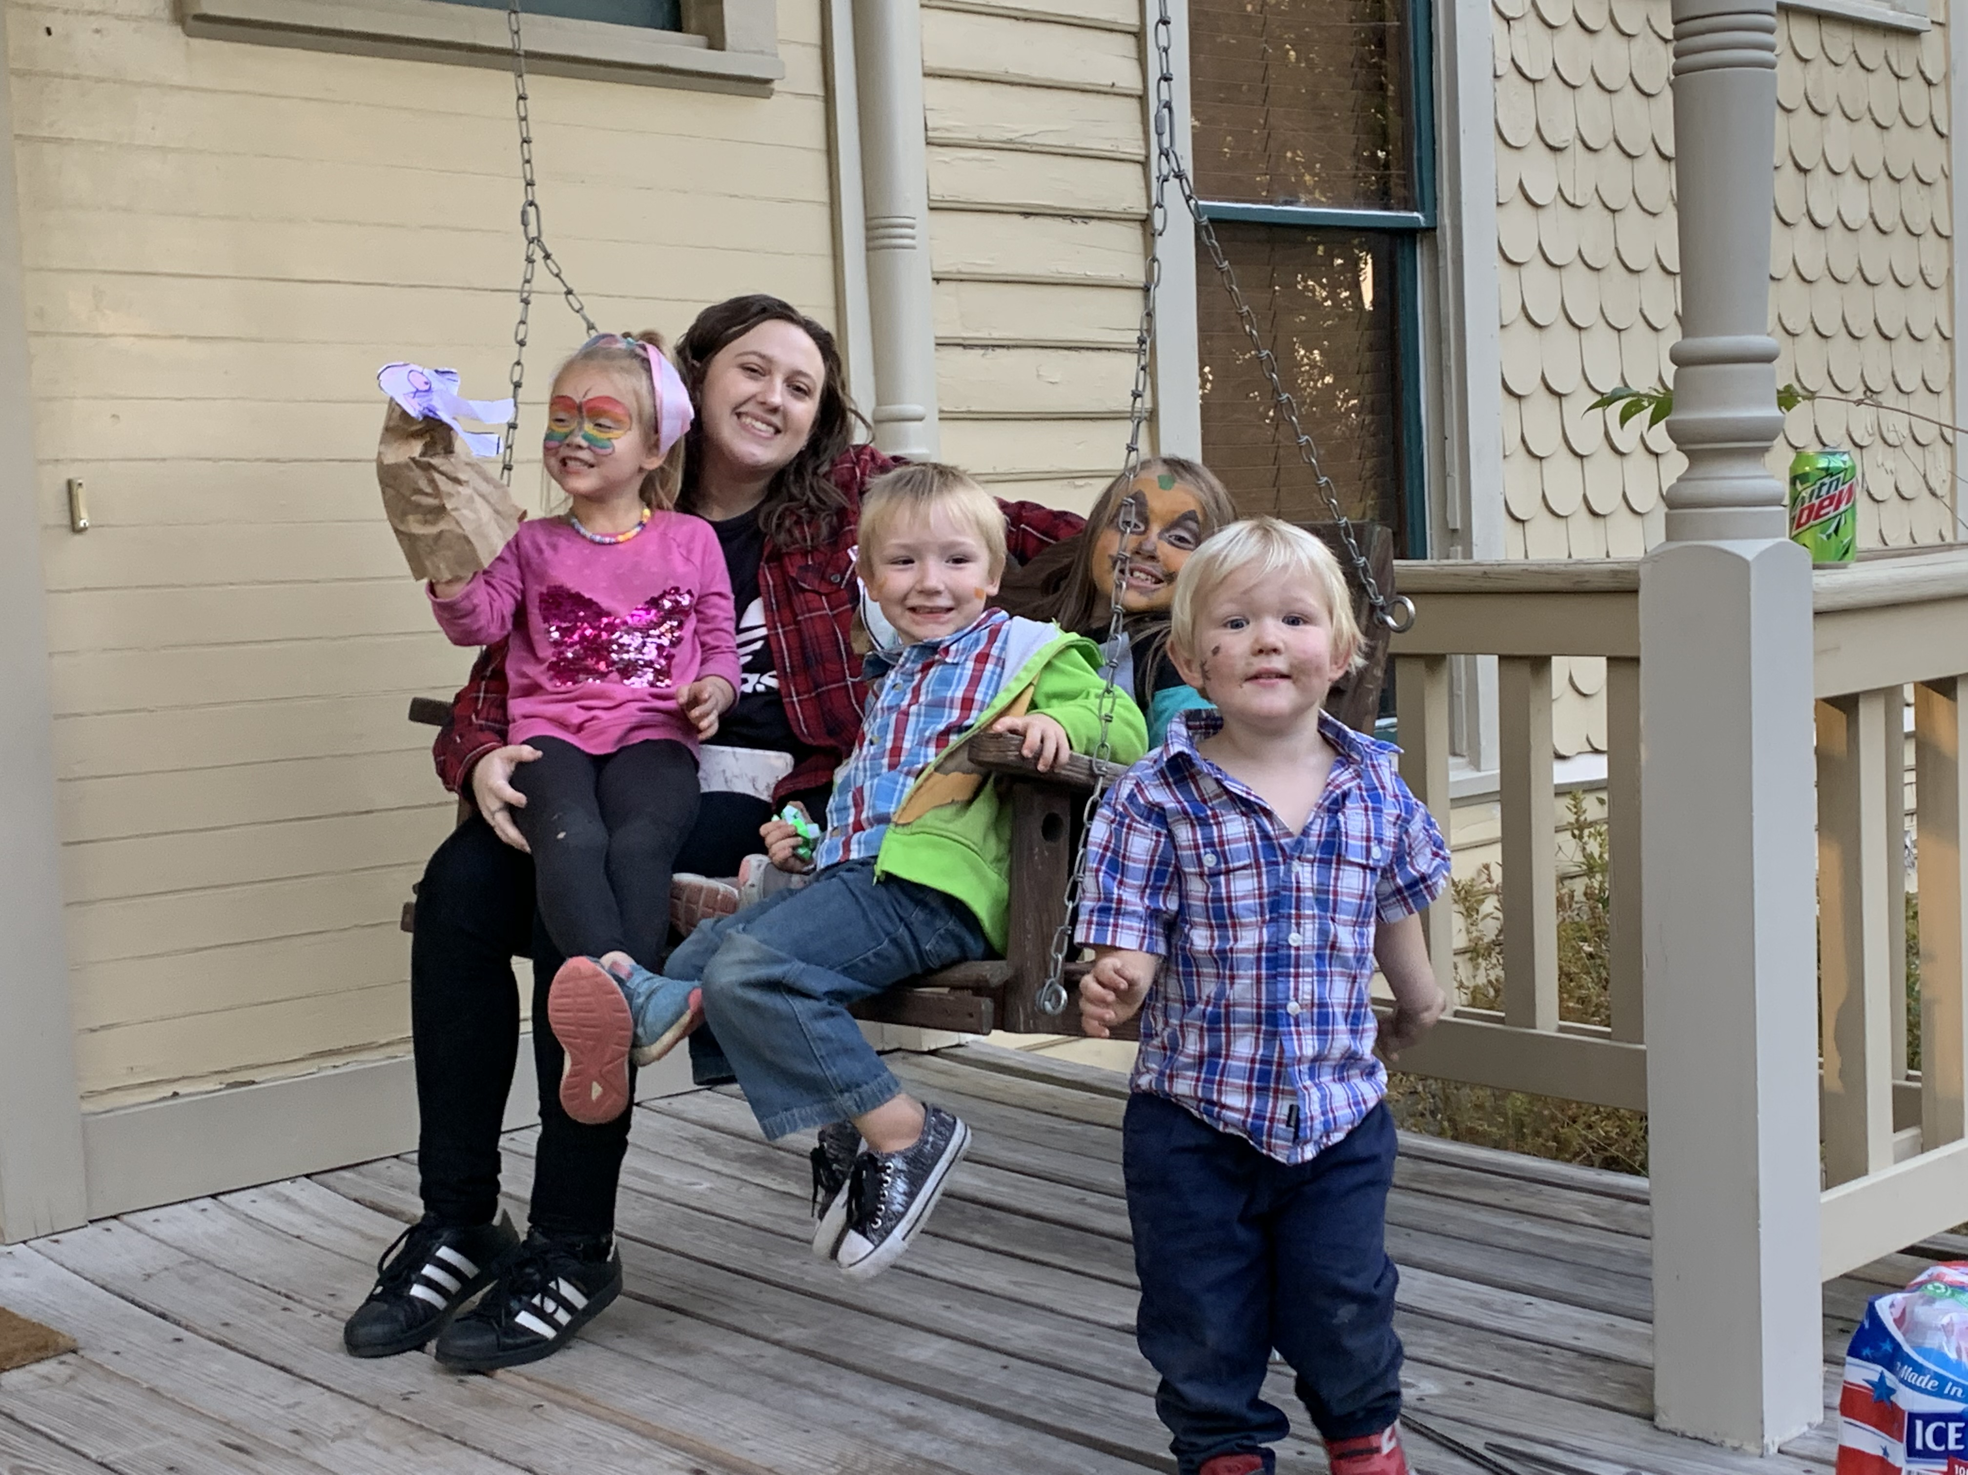

Mission in Action

